Slide 1

Chapter 2. Getting to Know Your Data: Data Description
Meng Jiang
CSE 40647/60647 Data Science Fall 2017
Introduction to Data Mining

Slide 2
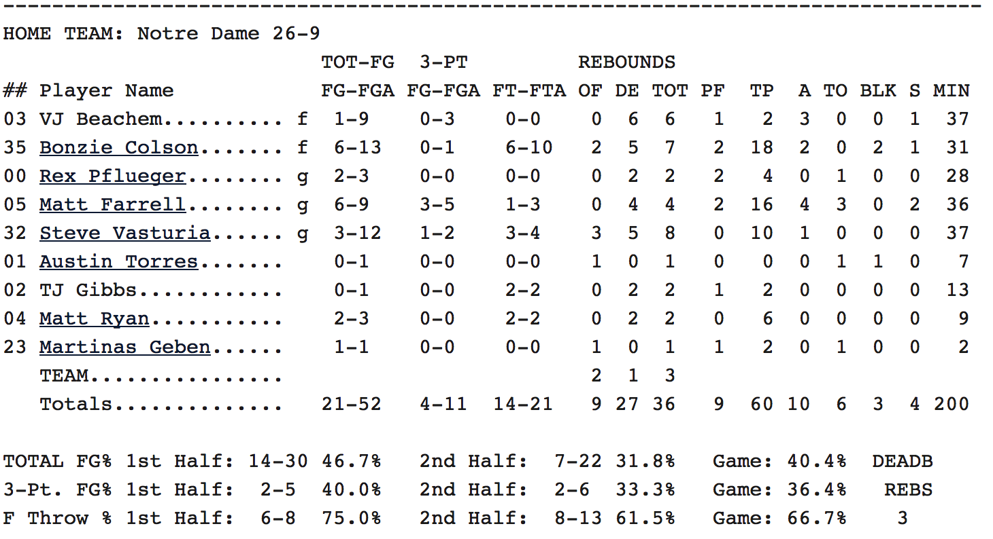
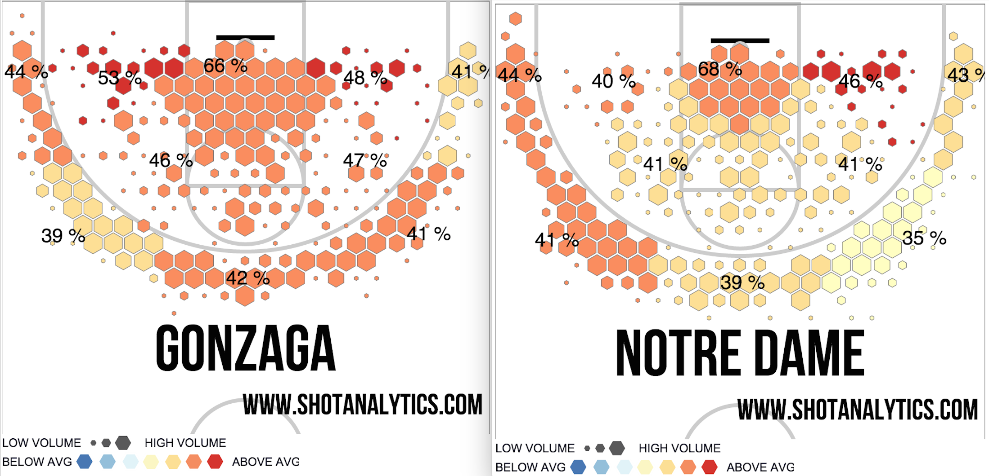
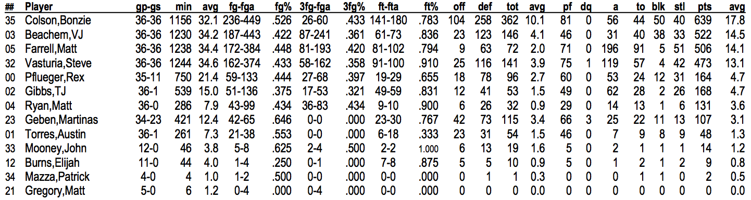
From Data to Knowledge

Slide 3
Chapter 2. Getting to Know Your Data
Data Objects and Attribute Types
Basic Statistical Descriptions
Data Visualization
Measuring Data Similarity and Dissimilarity

Slide 4
Types of Data Sets: (1) Record Data
Relational records in relational tables: highly structured
Transaction data
Document data: Term-frequency matrix of text documents
Notes:
Data objects, attribute types

Slide 5
Data Objects
Data sets are made up of data objects.
A data object represents an entity.
Examples:
Sales database: customers, store items, sales.
Medical database: patients, treatments.
University database: students, professors, courses.
Also called samples, examples, instances, data points, objects, tuples.
Data objects are described by attributes.
Database rows → data objects; columns → attributes.

Slide 6
Attributes
Attribute (or dimensions, features, variables)
A data field, representing a characteristic or feature of a data object
Types:
Nominal (e.g., red, blue)
Binary (e.g., {true, false})
Ordinal (e.g., {freshman, sophomore, junior, senior})
Numeric: quantitative
Interval-scaled: 100○C is interval scales
Ratio-scaled: 100○K is ratio scaled since it is twice as high as 50 ○K

Slide 7
Attribute Types
Nominal: categories, states, or “names of things”
Hair_color = {auburn, black, blond, brown, grey, red, white}
marital status, occupation, ID numbers, zip codes
Binary
Nominal attribute with only 2 states (0 and 1)
Symmetric binary: both outcomes equally important
e.g., gender
Asymmetric binary: outcomes not equally important.
e.g., medical test (positive vs. negative)
Convention: assign 1 to most important outcome (e.g., HIV positive)
Ordinal
Values have a meaningful order (ranking) but magnitude between successive values is not known
Size = {small, medium, large}, grades, army rankings

Slide 8
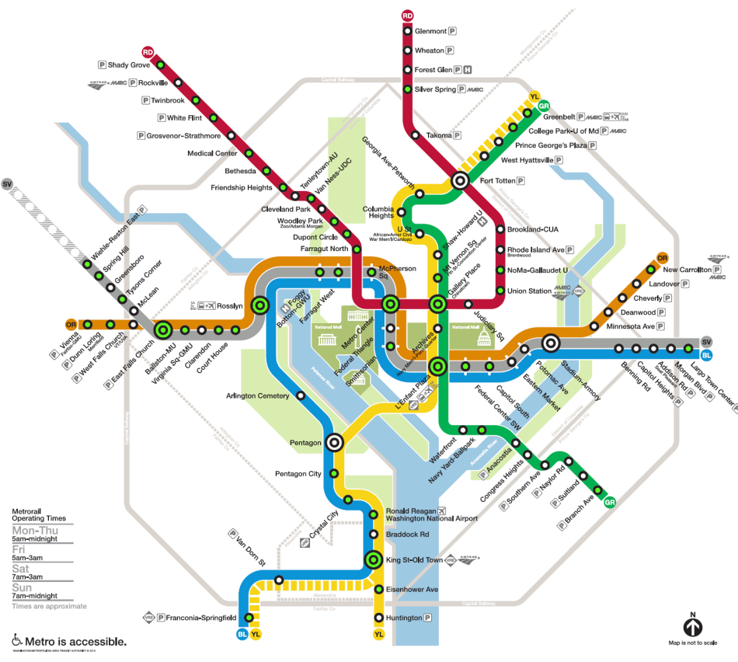
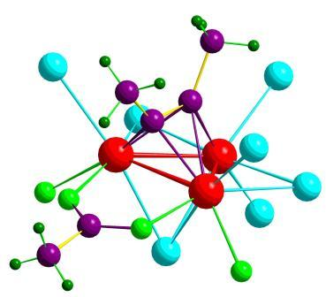

Types of Data Sets: (2) Graphs and Networks
Transportation networks
World Wide Web
Molecular structures
Social or information networks
Notes:
Data objects, attribute types

Slide 9
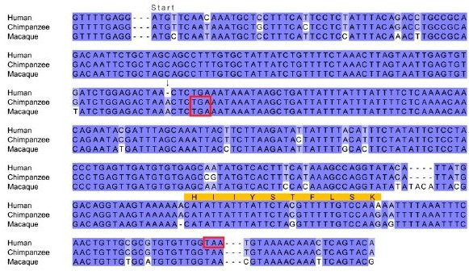
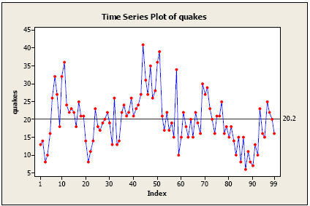
Types of Data Sets: (3) Ordered Data
Video data: sequence of images
Temporal data: time-series
Sequential Data: transaction sequences
Genetic sequence data
Notes:
Data objects, attribute types

Slide 10
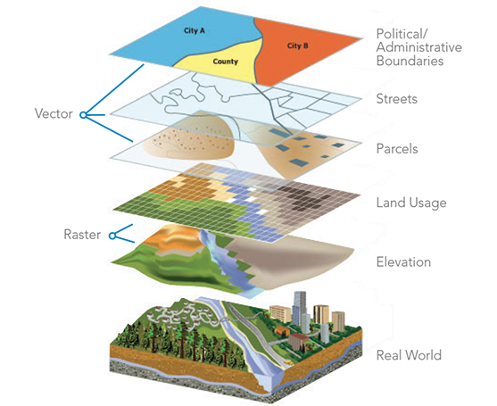

Other Types of Data Sets
Spatial data
Image and multimedia data
Notes:
Patterns, knowledge, data objects, attribute types

Slide 11
Chapter 2. Getting to Know Your Data
Data Objects and Attribute Types
Basic Statistical Descriptions
Data Visualization
Measuring Data Similarity and Dissimilarity

Slide 12
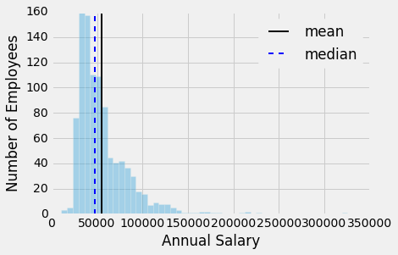
Basic Statistical Descriptions of Data
Motivation: to better understand the data
Data dispersion characteristics
Central tendency: Mean, median, mode, max, min …
Outlierness: Variance, standard deviation, Z-score …

Slide 13
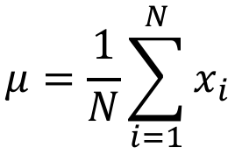
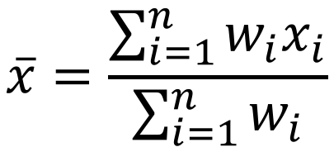
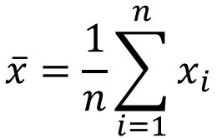
Measuring the Central Tendency: (1) Mean
Mean (algebraic measure) (sample vs. population):
Note: n is sample size and N is population size.
Weighted arithmetic mean:
Trimmed mean: Chopping extreme values
$$\overline{x}=\frac{1}{n}\sum_{i=1}^{n}{x_{i}}$$
$$μ=\frac{1}{N}\sum_{i=1}^{N}{x_{i}}$$
$$\overline{x}=\frac{\sum_{i=1}^{n}{{w_{i}x}_{i}}}{\sum_{i=1}^{n}{w_{i}}}$$

Slide 14
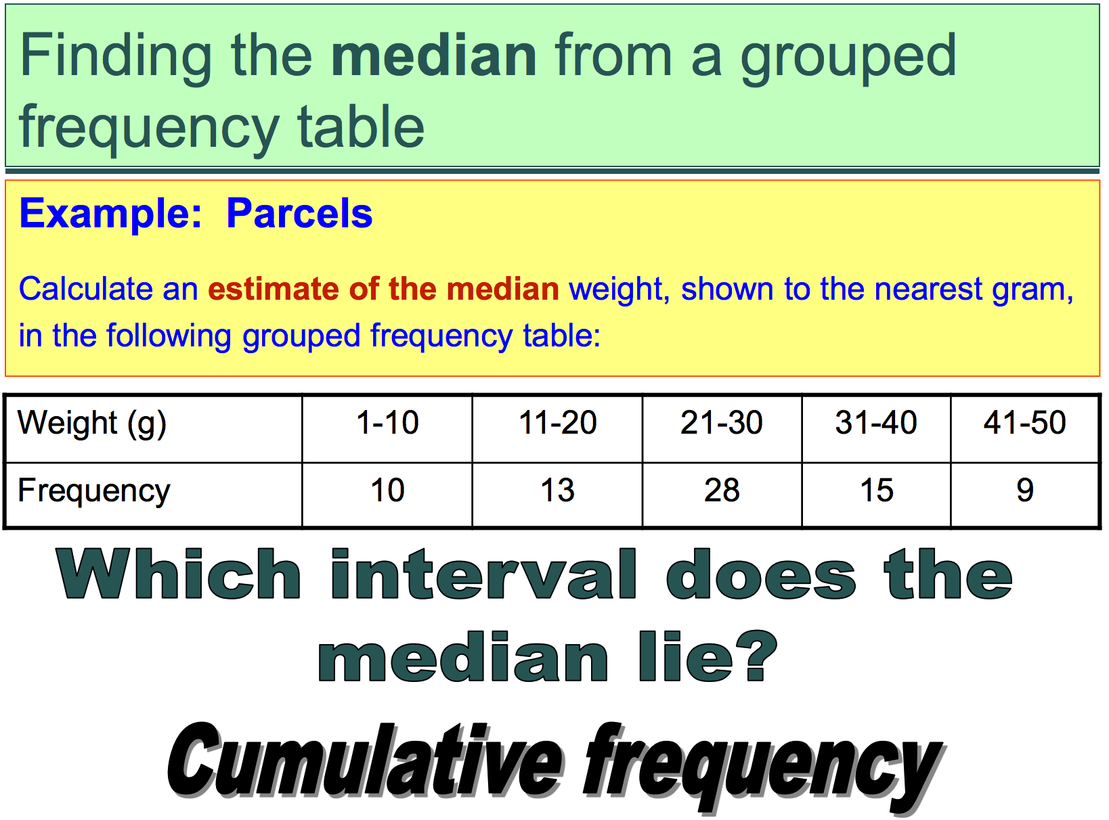
Measuring the Central Tendency: (2) Median
Median:
Middle value if odd number of values, or average of the middle two values otherwise
Estimated by interpolation (for grouped data):

Slide 15
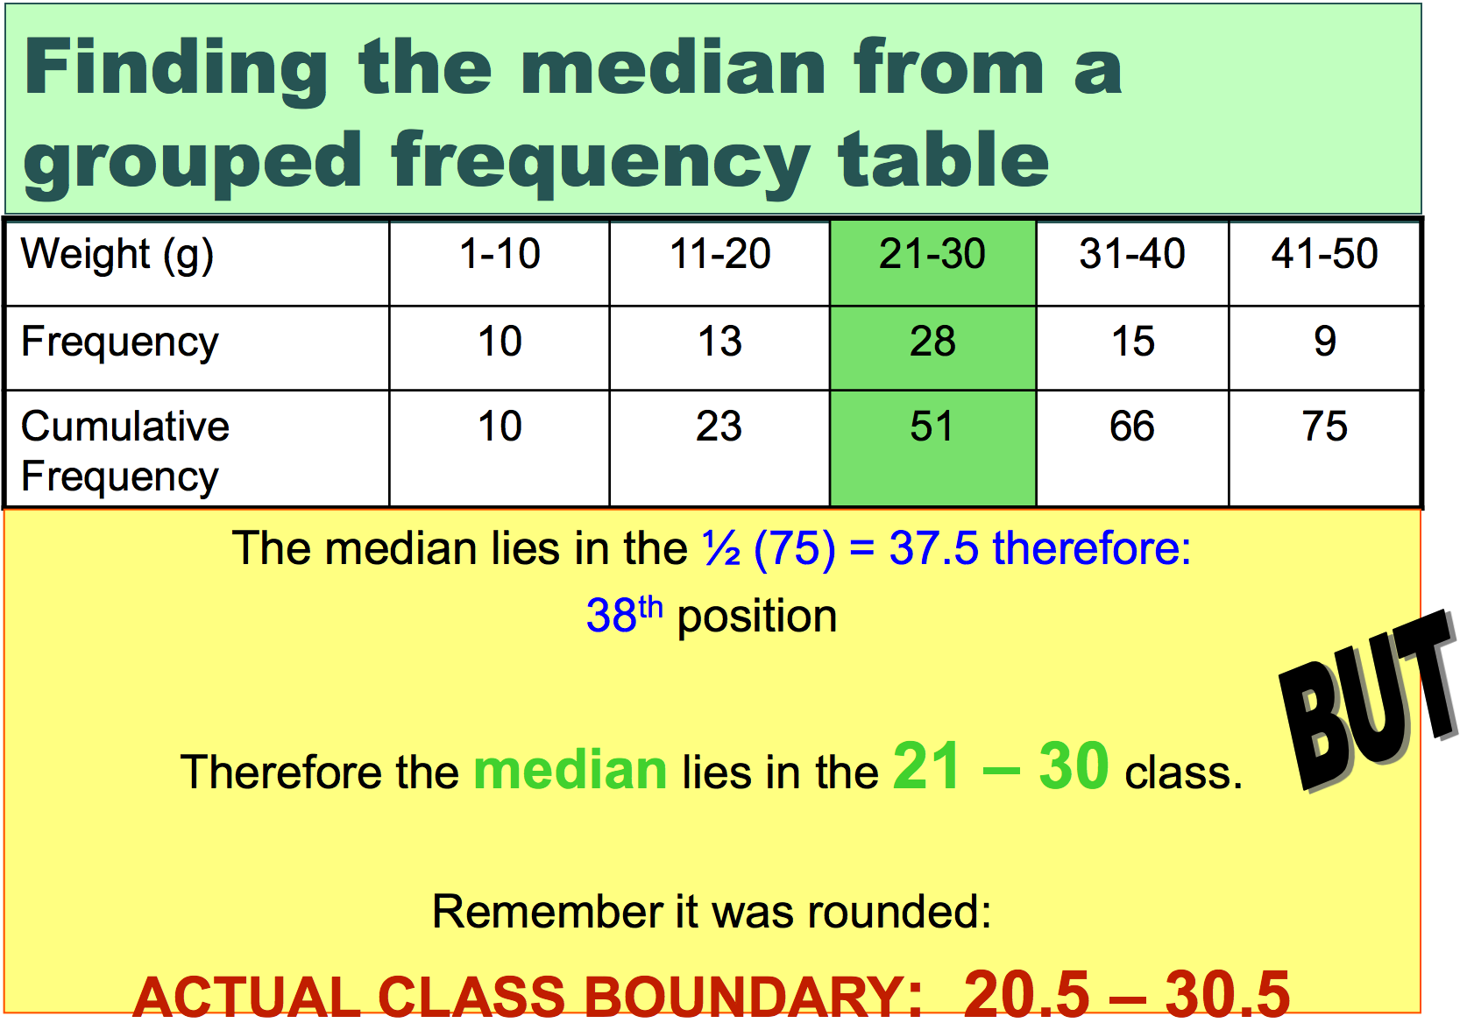

Slide 16
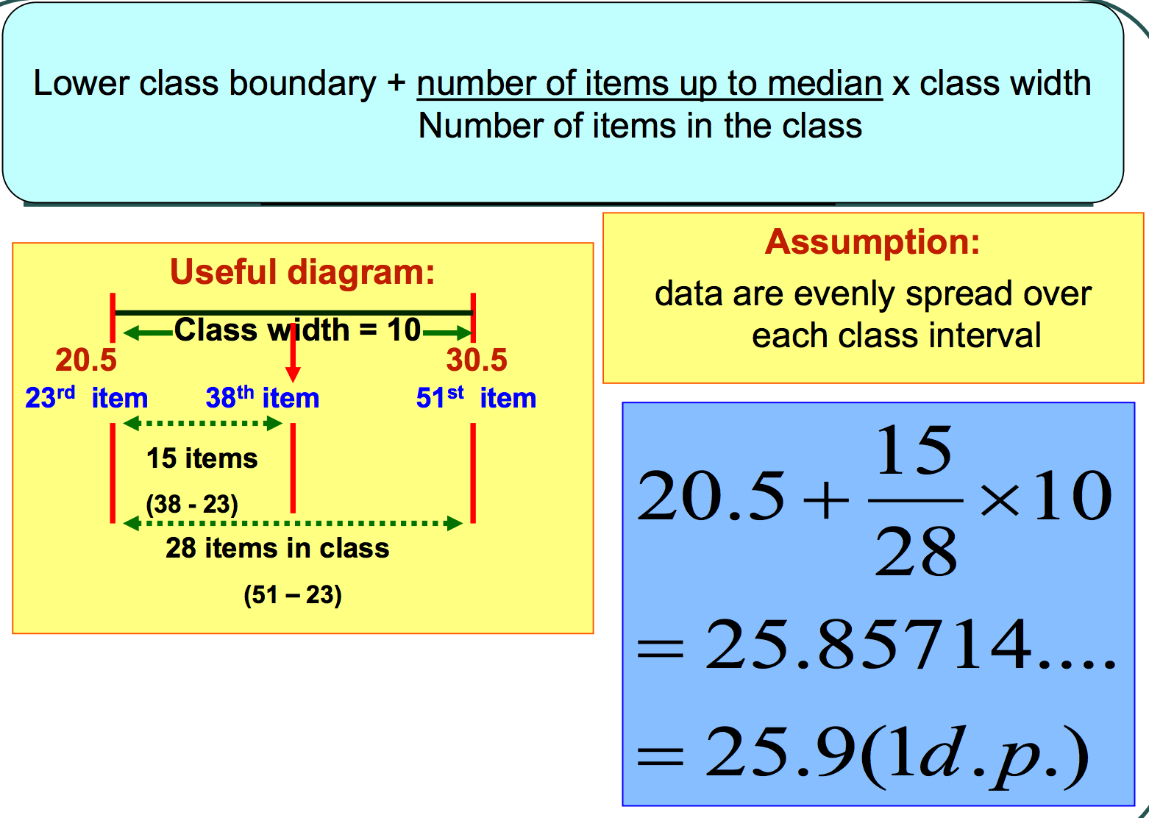

Slide 17
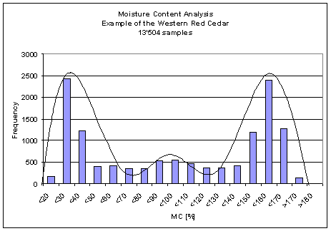
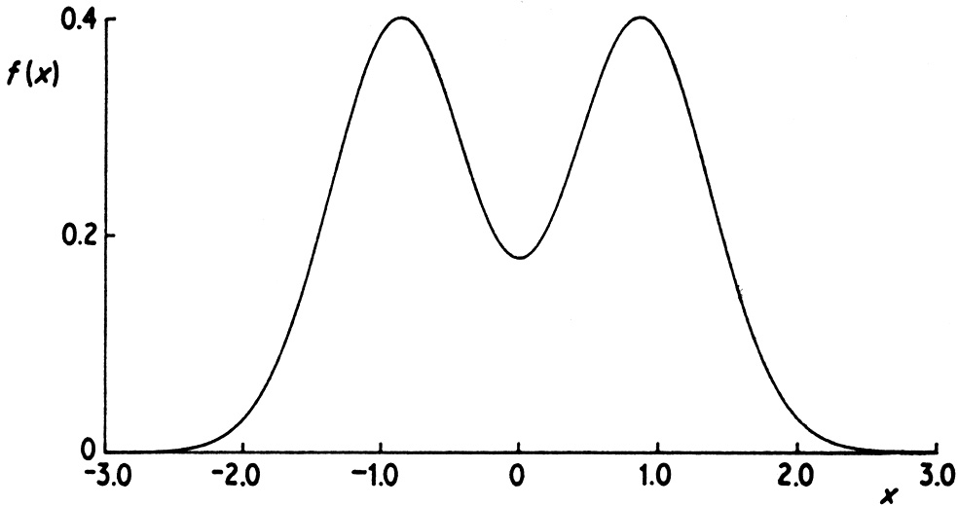
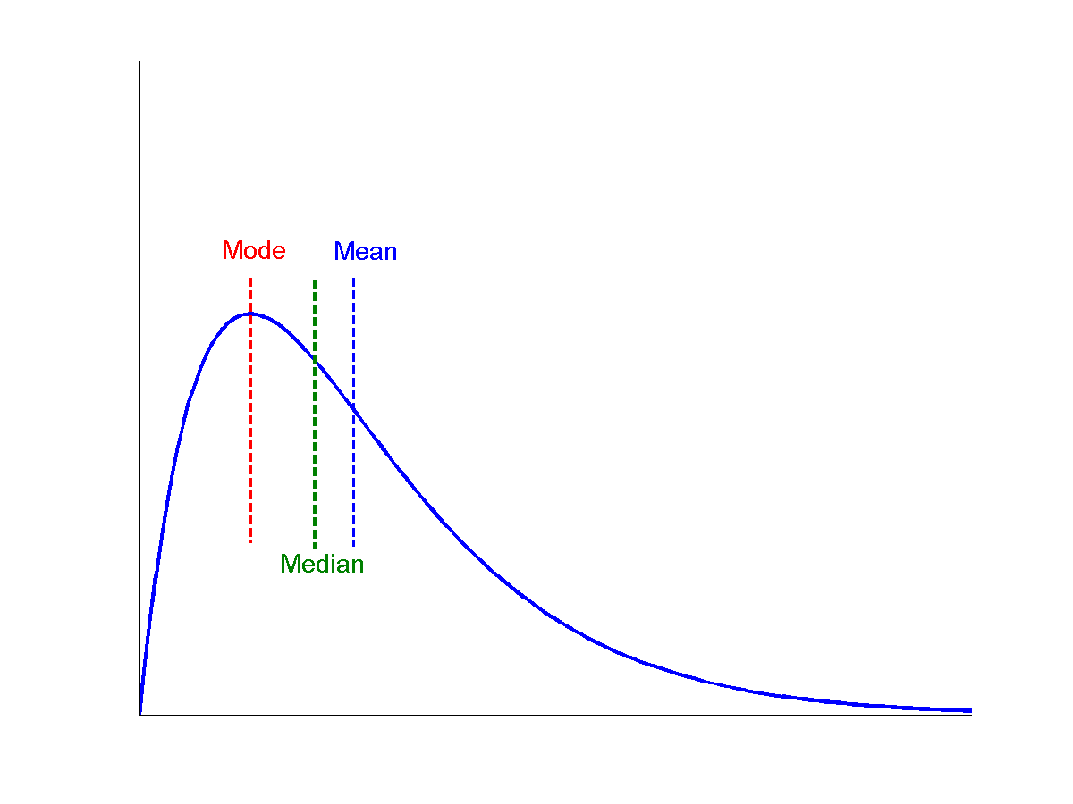
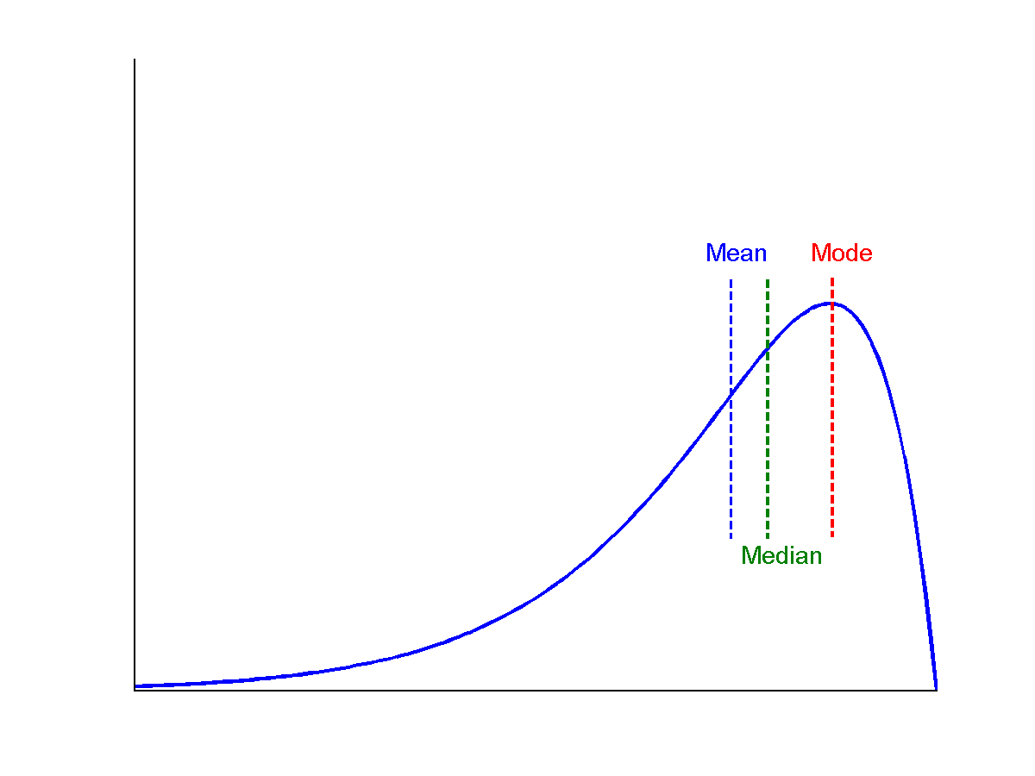
Measuring the Central Tendency: (3) Mode
Mode: Value that occurs most frequently in the data
Multi-modal
Bimodal
Trimodal
Symmetric data
Positively skewed data
Negatively skewed data

Slide 18
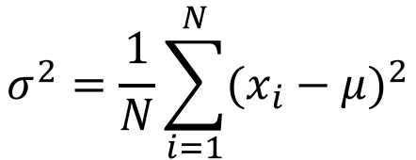
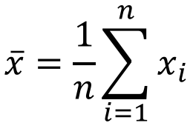
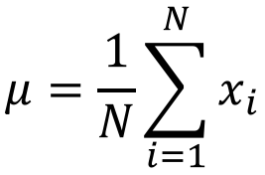
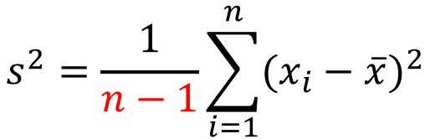
Measuring the Outlierness: Variance and Standard Deviation
Variance and standard deviation (sample: s, population: σ)
Variance: (algebraic, scalable computation)
Standard deviation s (or σ) is square root of variance s² (or σ²)
$$s^{2}=\frac{1}{n−1}\sum_{i=1}^{n}{{(x_{i}−\overline{x})}^{2}}$$
$$\overline{x}=\frac{1}{n}\sum_{i=1}^{n}{x_{i}}$$
Why?
$$σ^{2}=\frac{1}{N}\sum_{i=1}^{N}{{(x_{i}−μ)}^{2}}$$
$$μ=\frac{1}{N}\sum_{i=1}^{N}{x_{i}}$$

Slide 19
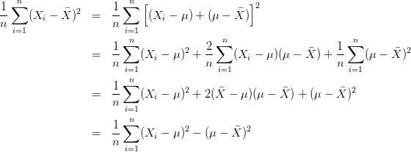

Biased Sample Variance
Biased
Unbiased
$$s^{2}=\frac{1}{n−1}\sum_{i=1}^{n}{{(X_{i}−\overline{X})}^{2}}$$
Bessel’s Correction: 3 alternative proofs of correctness

Slide 20
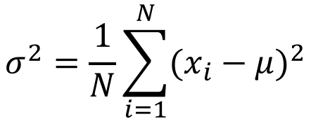
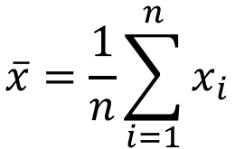
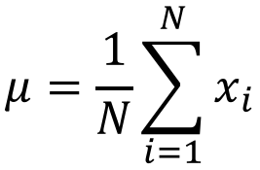

Measuring the Outlierness: Variance and Standard Deviation
Variance and standard deviation (sample: s, population: σ)
Variance: (algebraic, scalable computation)
Q: Can you compute it incrementally and efficiently?
Standard deviation s (or σ) is square root of variance s² (or σ²)
$$s^{2}=\frac{1}{n−1}\sum_{i=1}^{n}{{(x_{i}−\overline{x})}^{2}}$$
$$\overline{x}=\frac{1}{n}\sum_{i=1}^{n}{x_{i}}$$
$$σ^{2}=\frac{1}{N}\sum_{i=1}^{N}{{(x_{i}−μ)}^{2}}$$
$$μ=\frac{1}{N}\sum_{i=1}^{N}{x_{i}}$$

Slide 21
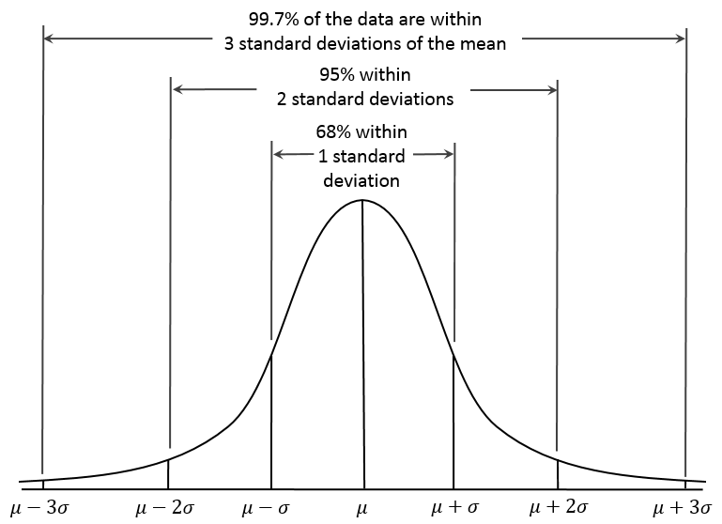
Measuring the Outlierness: Properties of Normal Distribution Curve
Z-score: The distance between the raw score and the population mean in the unit of the standard deviation
Z-score -3 -2 -1 0 1 2 3

Slide 22
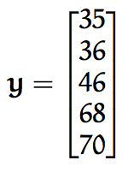
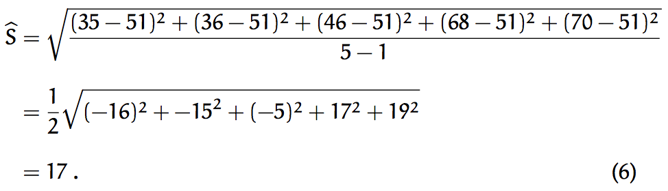
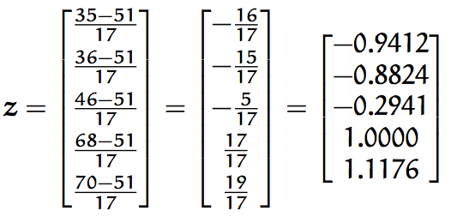
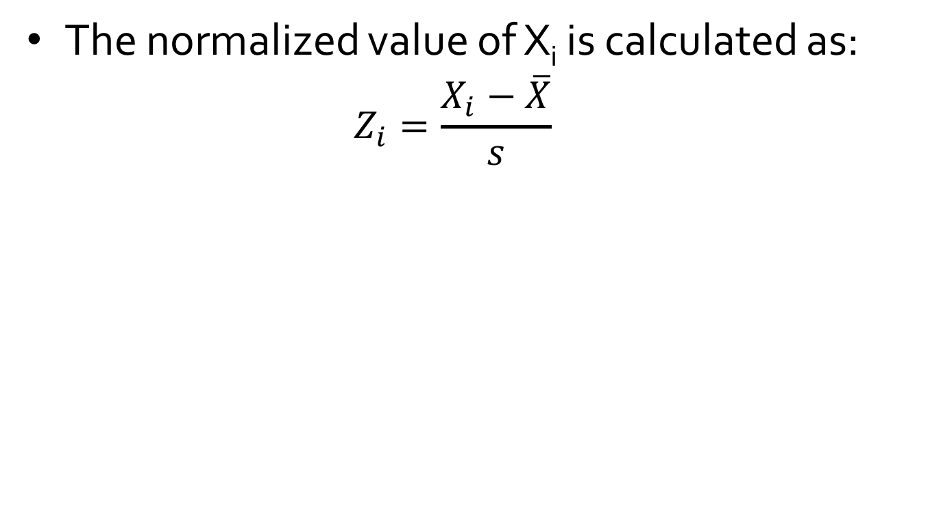
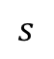
Z-score Normalization
The normalized value of X_{i} is calculated as:
$$Z_{i}=\frac{X_{i}−\overline{X}}{s}$$
$$s$$
vs. Min-Max Normalization:
[0, 1/35, 11/35, 33/35, 1] = [0, 0.0286, 0.3143, 0.9429, 1.0]

Slide 23
Discussion
Can you use Z-score to automatically find phrases?
If we have 1,000 “matrix” and 1,000 “factorization” in 1,000,000 words, and we assume independency, we should have only one “matrix factorization” (expected).
But actually we have more! - Outlierness
Jingbo Shang, Jialu Liu, Meng Jiang, Xiang Ren, Clare R Voss, Jiawei Han. “Automated Phrase Mining from Massive Text Corpora”. Submitted to Transactions on Knowledge and Data Engineering.

Slide 24
References
W. Cleveland, Visualizing Data, Hobart Press, 1993
T. Dasu and T. Johnson. Exploratory Data Mining and Data Cleaning. John Wiley, 2003
U. Fayyad, G. Grinstein, and A. Wierse. Information Visualization in Data Mining and Knowledge Discovery, Morgan Kaufmann, 2001
L. Kaufman and P. J. Rousseeuw. Finding Groups in Data: an Introduction to Cluster Analysis. John Wiley & Sons, 1990.
H. V. Jagadish et al., Special Issue on Data Reduction Techniques. Bulletin of the Tech. Committee on Data Eng., 20(4), Dec. 1997
D. A. Keim. Information visualization and visual data mining, IEEE trans. on Visualization and Computer Graphics, 8(1), 2002
D. Pyle. Data Preparation for Data Mining. Morgan Kaufmann, 1999
S. Santini and R. Jain,” Similarity measures”, IEEE Trans. on Pattern Analysis and Machine Intelligence, 21(9), 1999
E. R. Tufte. The Visual Display of Quantitative Information, 2nd ed., Graphics Press, 2001
C. Yu, et al., Visual data mining of multimedia data for social and behavioral studies, Information Visualization, 8(1), 2009

